Slide 1
HEAP Application Data Entry
Wizard Entry

Slide 2
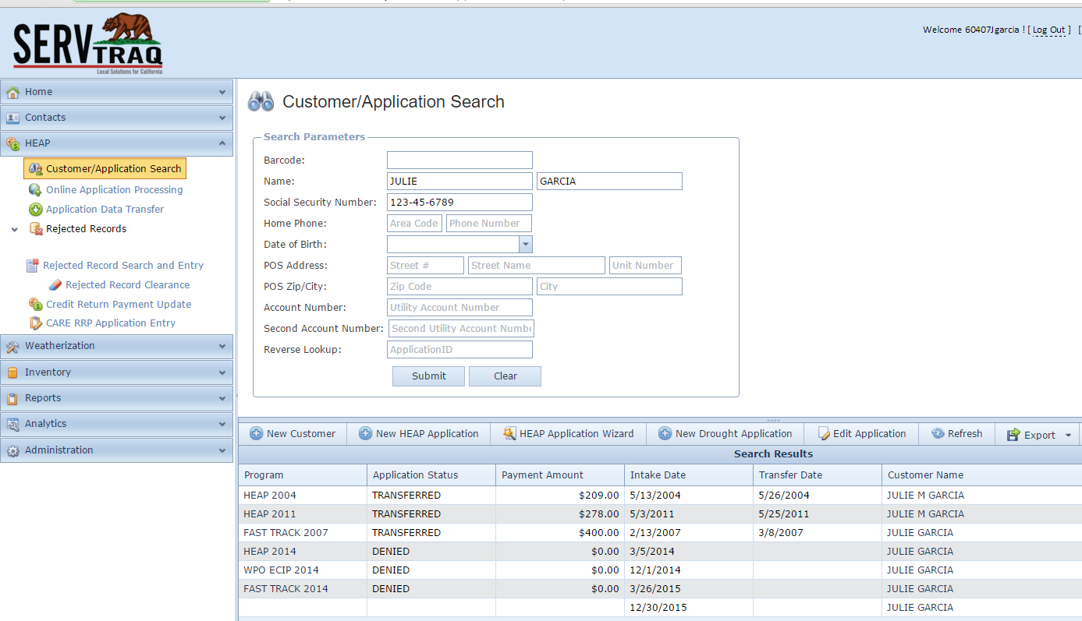
HEAP Application Wizard Entry
Try the HEAP Application Wizard Entry Design

Slide 3
Step 1:Customer Information
If you receive a “Phone Duplicate” Message in ServTraq check this box!
Start collecting e-mail addresses for a more efficient way of complying with the CSD 15 Day Written Notification requirement.
Julie@ServTraq.com

Slide 4
Step 2:Mailing Address
Only check the box if you receive a “Mailing Address duplicate” Message from ServTraq

Slide 5
Step 3: POS Address
Check the box to copy over the Mailing Address entered
Click the magnifying glass to generate LIWP leads from HEAP Applications (only applicable for LIWP Agencies).
Only check the box if you receive a “POS duplicate” Message from ServTraq

Slide 6
Step 4:Household Breakdown Summary Entry
See Attachment 1 for more information on Individual Entry

Slide 7
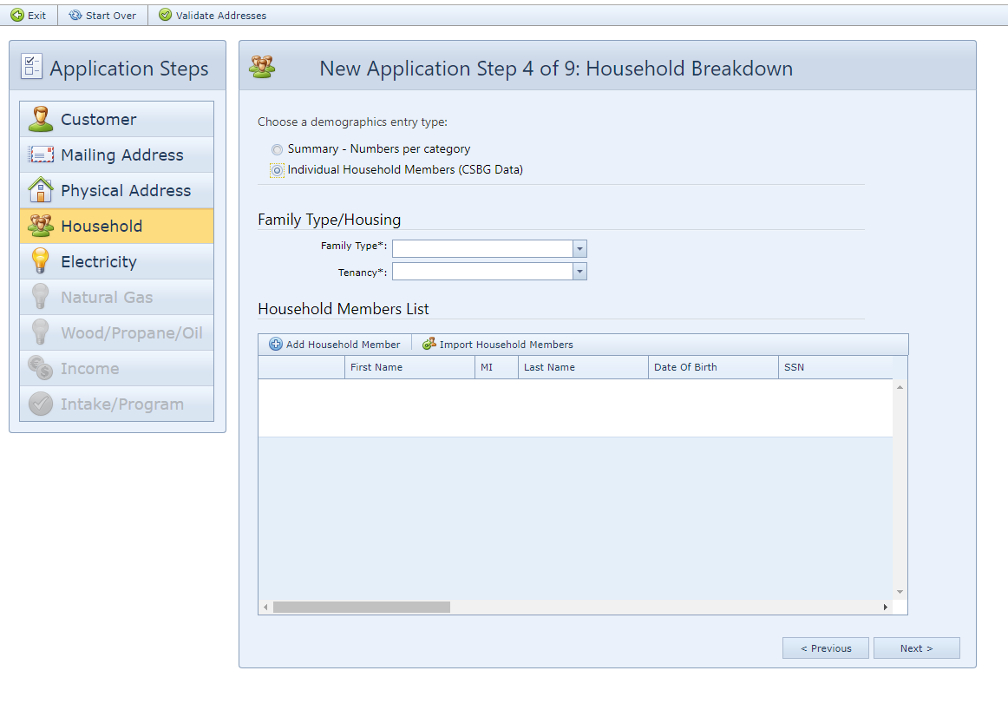
Step 4:Household Breakdown Individual Entry
See Attachment 1 for more information on Individual Entry. To minimize Individual Household member entry, use the Import HH Member feature to copy over household member entries from the most recent Payment Assistance Application in ServTraq

Slide 8
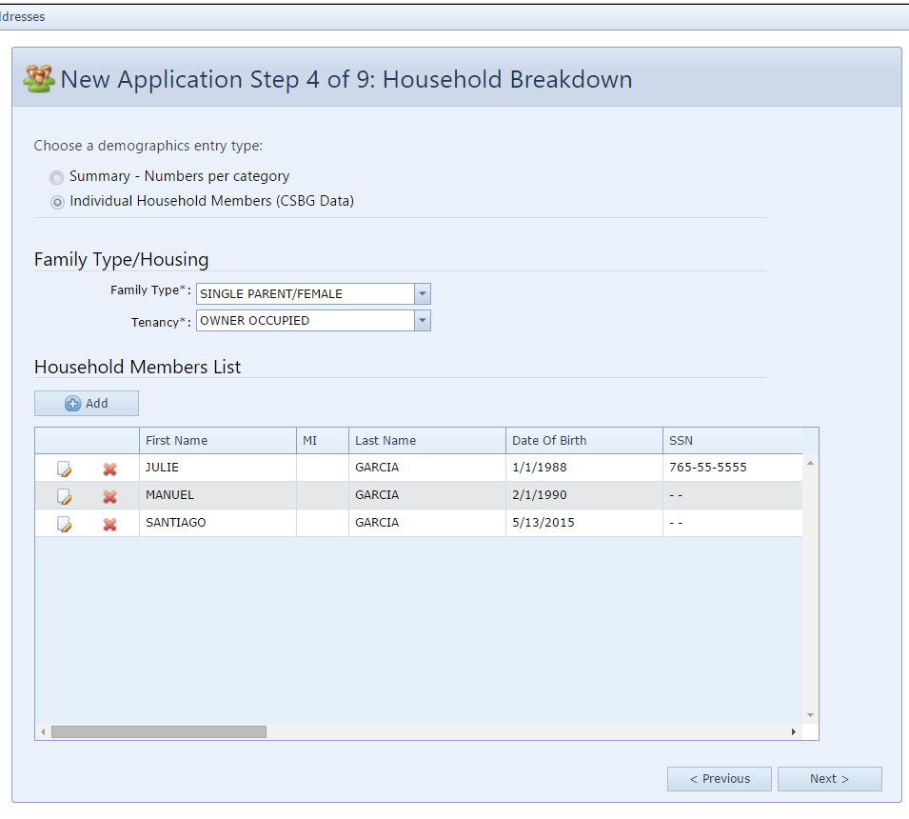
Step 4:Household Breakdown Individual Entry
Add, Edit or Delete household member entries as necessary.
Note: The household members added in this step will appear later in the Income Breakdown section.

Slide 9
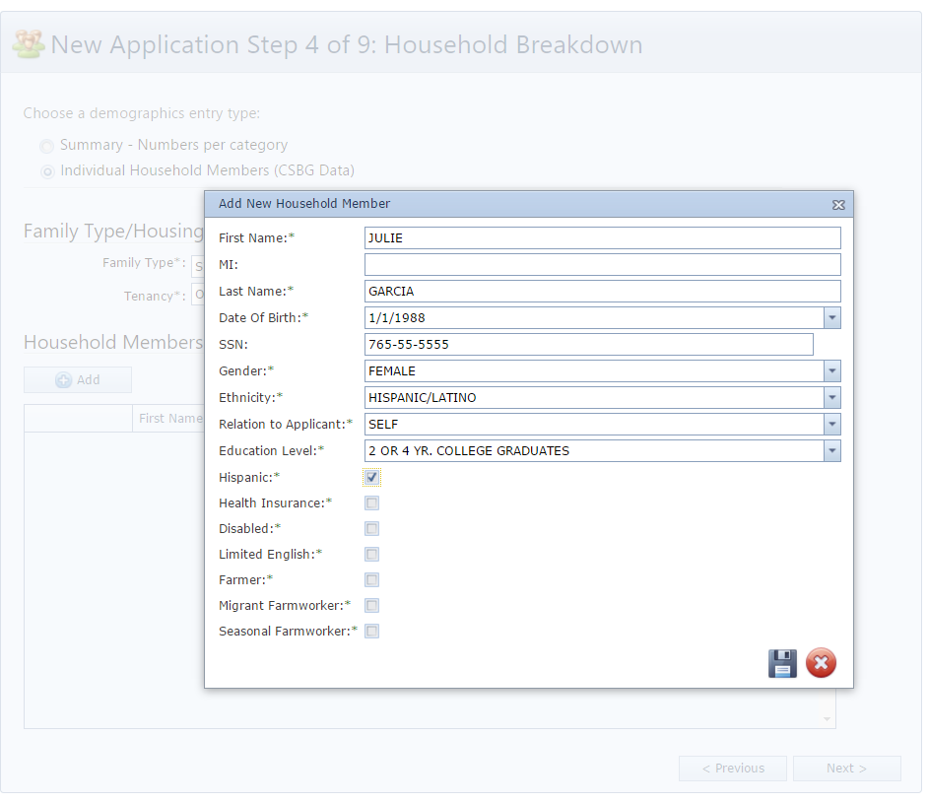
Step 4:Household Breakdown Individual Entry
If your agency does not collect certain information, default required values to “Other” when possible. For any other field just make a selection from the options available. This information is not transferred to CSD, and is only collected for CSBG Reporting.

Slide 10
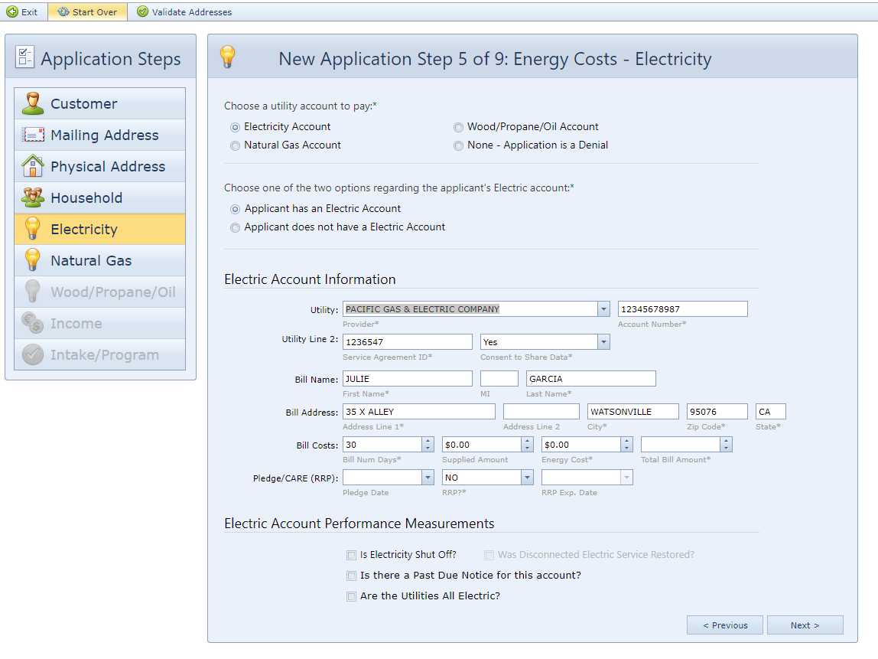
Step 5: Energy Costs- Electricity
Choose a Utility Account to Pay from the options provided—
Electric Account Information
Service Agreement ID
Consent Share Data
Supplied Amount: Use this field to calculate the monthly energy cost if the bill number of days is greater than 33.
Energy Cost: Monthly Energy Cost
Total Bill: Total Amount Due
Pledge Date: Use this field to log the date a pledge was made on the account.
RRP?: Identifies if the account is on a reduced rate program.
RRP Exp Date: PG&E Bills now display the CARE Enrollment Expiration Date. Use this field to track that information.

Slide 11
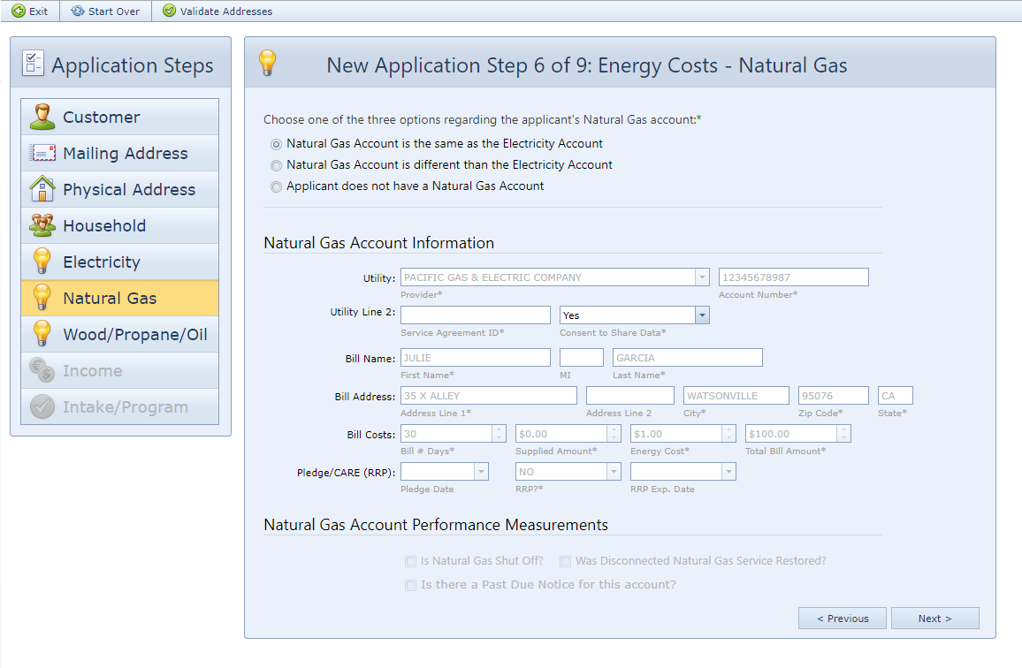
Step 5: Energy Costs- Natural Gas
ServTraq will skip this step if the utility selected for electricity is also a gas provider.
If that’s not the case, you’ll need select one of the options available.

Slide 12
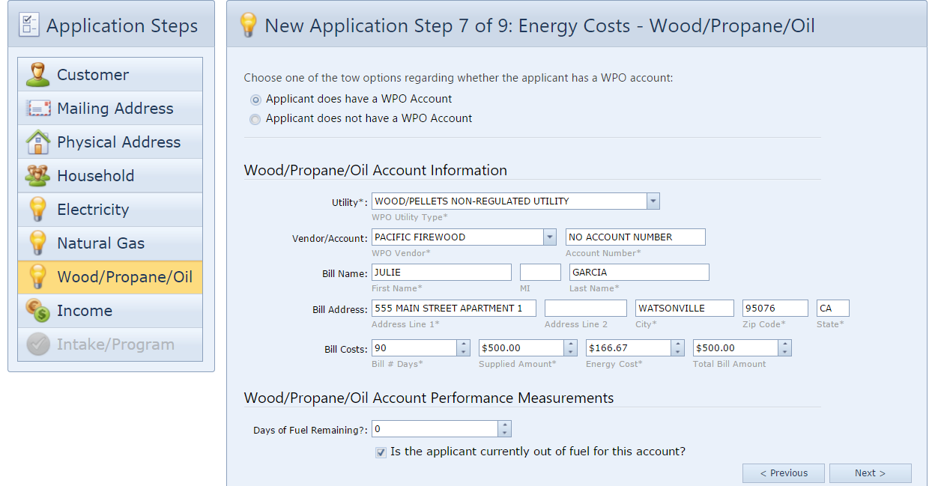
Step 5: Energy Costs- WPO
If the house is all electric, ServTraq will also skip this step
If not, select an option from the following—

Slide 13
Step 6: Household Income Summary Entry
If you used the “Summary” entry in the household breakdown (Step 4), use the “Summary” entry here.
The Number of Household Members Receiving Income defaults to the total number of adults in the household. Update this field if necessary and enter the total monthly countable income below.

Slide 14
Step 6: Household Income Individual Entry
If you used the “Individual” entry in the household breakdown (Step 4), use the “Individual” entry here to breakdown the household income by household member.
Click Add to create one Income entry for each household member.

Slide 15
Step 6: Household Income Individual Entry
The Income Recipient dropdown table is composed of the household members you added in Step 4 (if you used Individual entry).
Select the Income Type, Pay Period, and enter the Monthly (countable) Income.

Slide 16
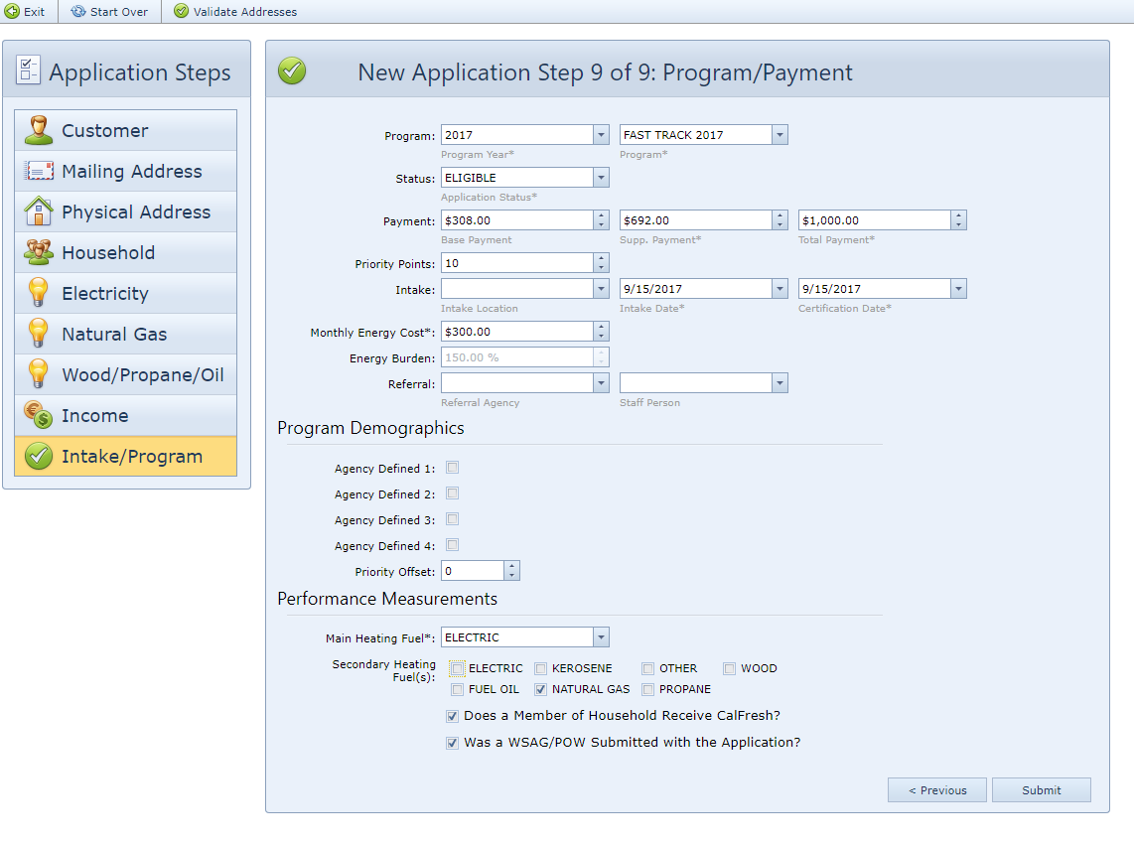
Step 7:Program/Payment
Enter the Program Information and Click Submit when finished. If all the ServTraq validations are met, you will receive the Application ID after.

Slide 17
Saved Application
Once the application is saved successfully, it’ll will open in “Scroll” Design. You can add additional Energy Accounts by clicking “Additional Energy” from the available application sections.

Slide 18
Additional Energy Accounts
You can add additional Energy Accounts by clicking “Additional Energy” from the available application sections.

Slide 19
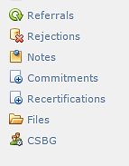
Payment Assistance Related Sections

Slide 20
Referrals
The Referral section is used to track applications referred from a partner organization.
Referral Entry Options:
Enter Referral Agency information in the Program/Payment section.
Manually entered after saving the application in the referral section.

Slide 21
Rejections
The Rejection section is used to track and clear rejected Payment Assistance Applications in CORE. Manual entry is required.

Slide 22
Notes
The Notes section allows additional space for miscellaneous comments.

Slide 23
Commitments
The Commitment section is used to log information about a pledge placed on a customer’s account. By logging a commitment, the customer’s information is sent to the Commitment Report.

Slide 24
Commitment Report
A Commitment Report is used to track commitments/pledges placed on customers accounts. This report can be made available to the corresponding utility company to streamline the process.
(Note: These are options available, but not all utility companies accept all methods.)
To View/Print Report click on Reports>Daily Reports> Commitments to Send to Utility.

Slide 25
Recertification
If Eligibility for WX Services is derived from a HEAP application, use the Recertification section to log the eligibility recertification date. The 120 day count from Certification to Assessment date will restart to the date entered.

Slide 26
Files
The Files section allows users to upload and attach documents to Payment Assistance Application that have been entered and saved in ServTraq.
Note: You can create specific folders to upload documents by clicking on the folder icon.

Slide 27
Files
Symbol Icon | Meaning
 | Rename the document uploaded
 | Move – the document to another folder
 | Copy – make a copy of the document uploaded and save it into another folder.
 | Delete the document upload
 | Refresh page
 | Download documents uploaded
 | Detail View or Thumbnail View of documents uploaded
 | Exit File Manager
To Upload Files:
Select the folder to upload file. Click the Browse button and select file to upload. Click Upload to save in ServTraq.

Slide 28
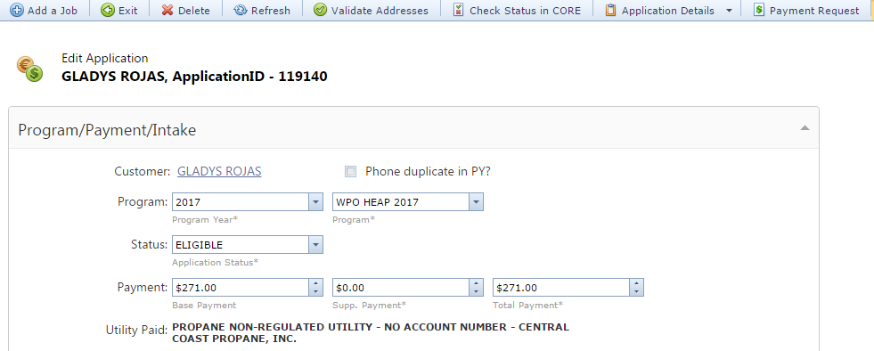
WPO Payment Request
ServTraq offers user the ability to create WPO Payment Request right from the application, which formalizes the Fiscal request for payment.

Slide 29
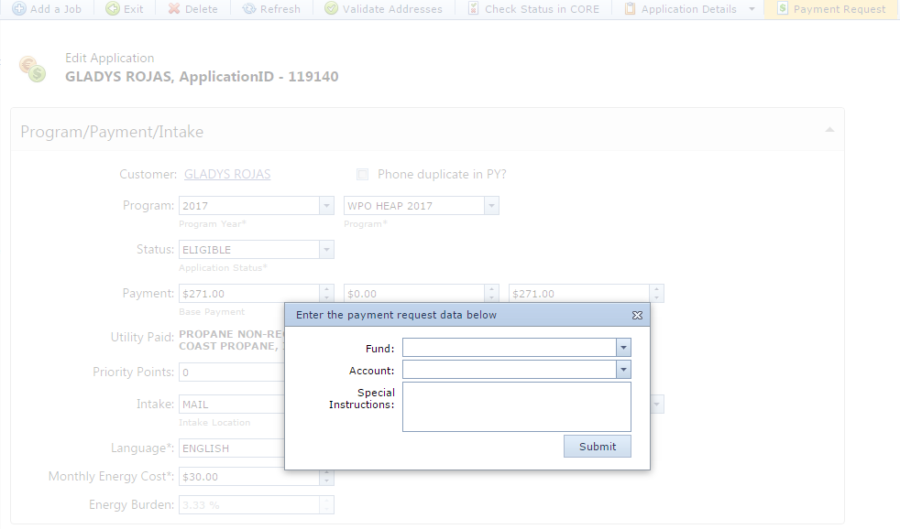
WPO Payment Request
Start by clicking on the Payment Request button> a small window appears enter the Fund and Account you want to use (Typically, these are provided by Accounting)> click Submit.
IMPORTANT!!!!!!
One time option! Make sure all information is correct before clicking Submit.

Slide 30
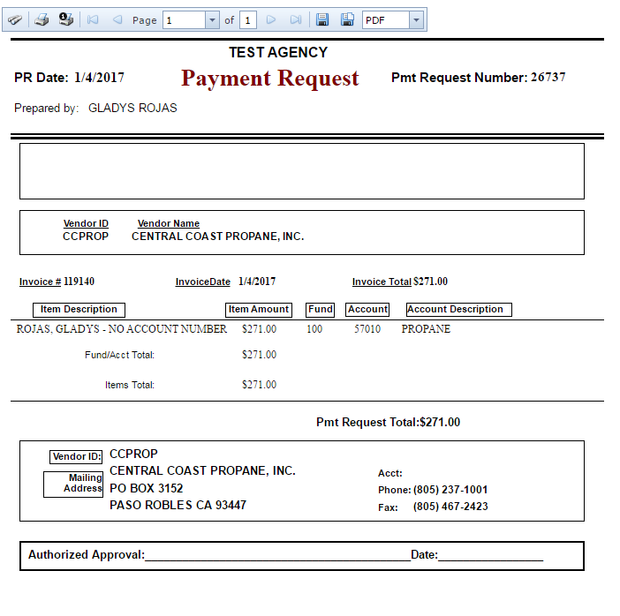
WPO Payment Request
Example of a Payment Request.
The Payment Request generates with the information entered during Payment Assistance Data Entry.
Invoice # equals the Application ID Number/ACC.
Invoice Total & Pmt Request Total equals the Awarded Amount.
Vendor Information populates as selected during data entering.
.

Slide 31
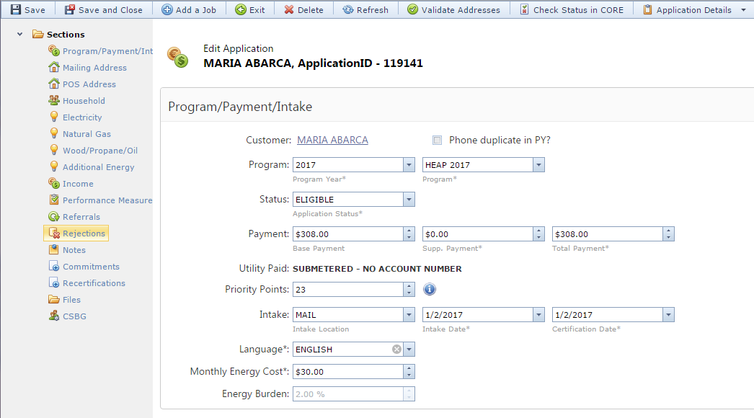
CSD 43 Form
ServTraq offers users the ability to print out a completed CSD 43 Form after a payment assistance application has been entered.
Click on Application Details> Select the from the PDF or Excel Format to print.

Slide 32
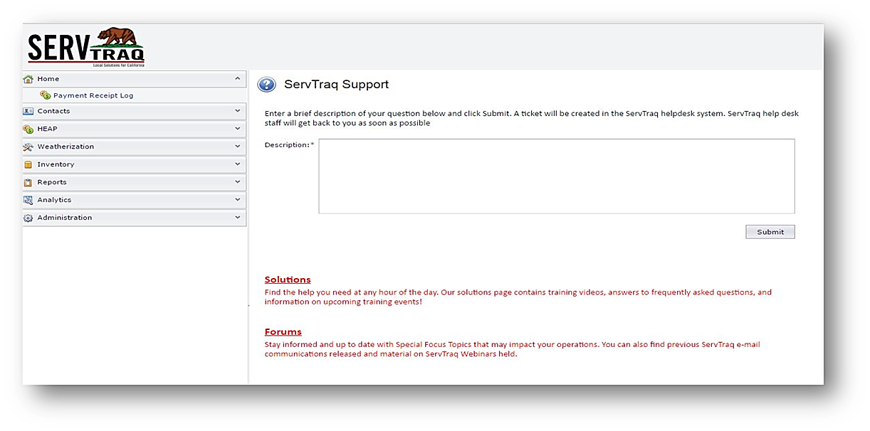
Questions
Visit our Solutions page
Email us at: Support@ServTraq.com
Contact us: (831) 761-1747

